Slide 1
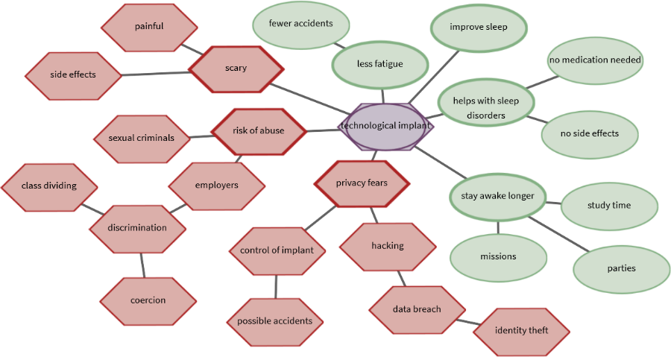
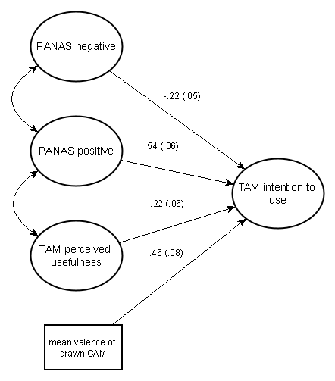

Predicting technology acceptance using CAMs as an additional measurement tool to questionnaires
Use of a technology can be predicted according to the technology acceptance model (Venkatesh & Bala 2008). Thereby, questionnaires assess previously known influencing variables. To identify further influential factors on technology acceptance so called "Cognitive Affective Maps" (CAMs) can be applied (e.g. Livanec et al. 2020). CAMs are a quantitative and qualitative research tool to identify, visually represent and analyze existing belief structures or attitudes.
Figure 1. CAM drawn by a participant concerning the acceptance of a fictional nano implant
Only recently have CAMs been increasingly researched quantitatively (e.g. Reuter et al. 2021), and currently Therefore I am working on an R package to quantitatively analyze these kinds of networks (aggregating CAMs, computing complex network indicators…).
Pilot study
N=90 participants, 2x2 mixed design
Answered questionnaire scales and drew a CAM regarding a scenario text
Treatment: participants were presented a CAM with the opposite affective connotation to their previously CAM; Control group
> two central hypotheses (which will result in two publications after replication in a larger sample size):
Can CAM data provide additional information to questionnaires and thus have an additional predictive value?
Does the treatment have a measurable impact beyond the (possible) temporal instability of CAMs?
Preliminary data analyses
Hypothesis 1. Using structural equation models it is possible to structurally analyze the acceptance process of a fictional technology. To account for the non-normal distribution of the questionnaire items and the small sample, the DWLS estimator was used and the $X^{2}$ statistic was mean and variance adjusted (e.g. Hancock & Mueller 2013):
Figure 2. Predicting intention to use the nano implant
Hypothesis 2. The study design is a mixed design with 2 (within) x 3 (between) levels. This allows the use of multivariate multilevel models (Lischetzke et al. 2015) to measure the effect of the treatment:
predictors | est (se)
Constant | -0.120 (0.079)
post | 0.149 (0.091)
neg. CAM presented | 0.515 (0.142)***
pos. CAM presented | -0.464 (0.145)***
factor scores PANAS neg. | -0.122 (0.059)**
post x neg. CAM presented | -0.757 (0.162)***
post x pos. CAM presented | 0.564 (0.169)***
post x factor scores PANAS neg. | -0.131 (0.072)*
Hancock, G. R., & Mueller, R. O. (Eds.). (2013). Structural equation modeling: A second course. IAP.
Lischetzke, T., Reis, D., & Arndt, C. (2015). Data‐analytic strategies for examining the effectiveness of daily interventions. Journal of Occupational and Organizational Psychology, 88(3), 587-622.
Livanec S., Stumpf, M., Reuter L., Fenn J. & Kiesel A. (2021). Who’s gonna use this? Psychological acceptance prediction of emerging technologies and transdisciplinary considerations in the Anthropocene. Manuscript submitted for publication.
Reuter, L., Fenn, J., Bilo, T. A., Schulz, M., Weyland, A. L., Kiesel, A., & Thomaschke, R. (2021). Leisure walks modulate the cognitive and affective representation of the corona pandemic: Employing Cognitive‐Affective Maps within a randomized experimental design. Applied Psychology: Health and Well‐Being.
Venkatesh, V., & Bala, H. (2008). Technology acceptance model 3 and a research agenda on interventions. Decision sciences, 39(2), 273-315.
Table 2. Predicting mean valence of drawn CAM
Exploring cognitive affective maps as a new mode of data collection
Julius Fenn, University of Freiburg
Notes:
2-column design for graphic-heavy posters
Adjust font sizes to fit Title & Authors in one line each (but no smaller than 12pt!)
IMPORTANT: This template uses the font "Lora" for titles (it is also used in the SMiP logo). You can download (and then install) the font from
https://fonts.google.com/specimen/Lora
(it is licensed under the SIL Open Font License (cf. http://scripts.sil.org/OFL) which means you can use it freely (except for commercial purposes))

